Slide 1
A HMM Based on Daily Return for SSE
Chen Zhiyun 1501213406

Slide 2
Fctor Screening
Here I test 10 indicators in largest retracement, return to retracement and success rate.
indicator | swing | Logreturn | logreturn5 | boll | cci | dma | kdj | mtm | macd | sar
Largest retracement | 15% | 37% | 24% | 32% | 22% | 26% | 24% | 19% | 20% | 30%
Return to retracement | 24 | 3.8 | 15 | 9.6 | 25 | 9.1 | 12 | 22 | 15 | 8.7
Success rate | 85% | 55% | 70% | 53% | 64% | 53% | 51% | 64% | 53% | 53%

Slide 3
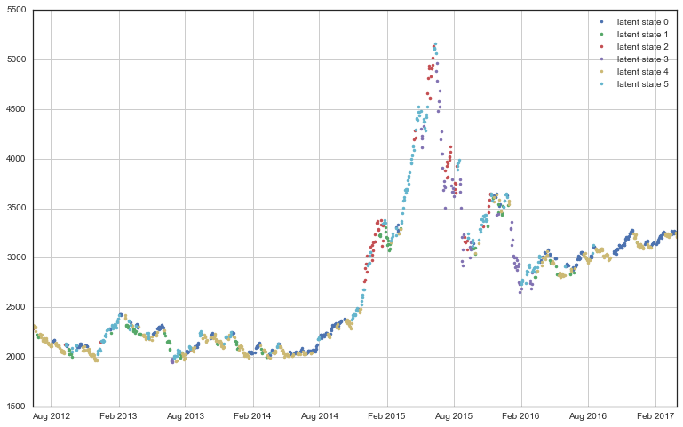
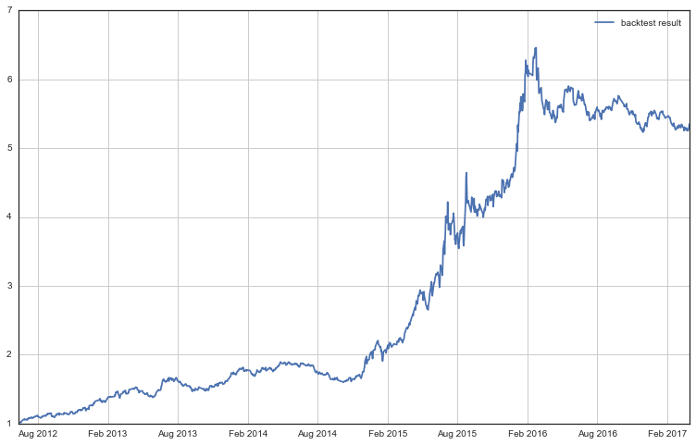
Finally, I choose swing and logreturn5 as my input factor.
Return in test period: 533%
Annualized return: 41%
Largest retracement: 19%
Return to retracement: 28
Success rate: 52.4%

Slide 4
A tradeoff
Number of latent variables vs. running time
Number of latent variables | 6 | 9 | 12 | 15 | 18
annualized return | 41.0% | 38.5% | 46.4% | 55.6% | 57.8%
Largest retracement | 19% | 19.8% | 13.6% | 18.1% | 12.4%
Return to retracement | 28 | 26.8 | 55.3 | 45.5 | 74.2
Success rate | 52.4% | 55.4% | 57.7% | 65.2% | 68.3%
time | 1.6407 | 2.5501 | 4.8797 | 7.9901 | 16.031

Slide 5
Other thinking
In factor screening part, I find the result of logreturn5 is obviously better than logreturn. Is it means that hmm is more accurate in long period. I did another test on 1 day(1), 1 week(5), half a month(10), 1 month(20), three month(60).
indicator | Logreturn | logreturn5 | logreturn10 | logreturn20 | logreturn60
Largest retracement | 37% | 24% | 29% | 15% | 27%
Return to retracement | 3.8 | 15 | 13 | 31 | 7.1
Success rate | 55% | 70% | 58% | 74% | 63%

Slide 6
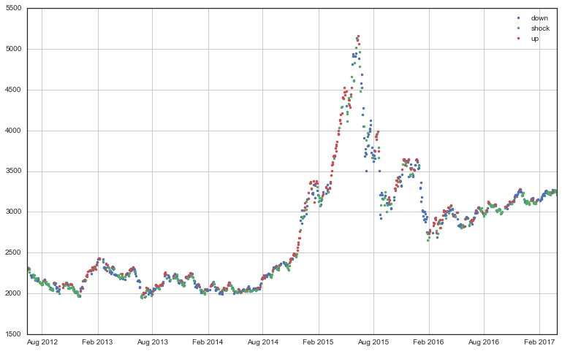
Other thinking
How to optimize our trading strategy?
Don’t trading every day
Buy and hold
sell
buy

Slide 7
Conclusion
The HMM model based on the daily return has such a high yield and high winning rate because of its ability to form recognition and automatic switching strategy.
In trend market, like many momentum strategies, the model can seize the trend in the case of reducing the frequency of transactions, as much as possible to share the benefits of the entire trend.
In the shock market, our model can acquire short-term or even shortshort-term gains through increasing the number of transactions and improving profit to loss ratio and winning probability.

Slide 8
Thank you

